Slide 1
Halide
By: Shameer, Gurkirat, Marcus, & Jonathan

Slide 2
What is Halide?
Halide is a domain-specific language (DSL) that's embedded in C++
Designed for image processing, computer vision, and scientific computation
Algorithms are efficient and achieve optimal performance across hardware platforms
Notes:
Primary purpose is to write efficient algorithms for tasks like image processing, computer vision, and scientific computation while achieving optimal performance across various hardware platforms.

Slide 3
Why was Halide created?
Halide was developed to solve the trade-off between productivity and performance.
Writing fast image processing code in C++ is very difficult and requires manual optimization for different hardware, which is time-consuming and prone to errors
Halide allows developers to write clean, concise algorithms

Slide 4
History of Halide
Created in 2012 at MIT, helped by Adobe and Google
Prominent creators are Jonathan Ragan-Kelley and Andrew Adams
The name “Halide” comes from silver halides which are a light sensitive compound used in photography
The 2013 Research Paper “Decoupling Algorithms from Schedules for Easy Optimization of Image Processing Pipelines” won the ACM SIGPLAN award for best paper

Slide 5
What is Halide Used For?
Halide is primarily used in applications that require high-speed, complex image and signal processing
Computational Photography: Noise reduction, HDR imaging, panorama stitching, and focus stacking
Machine Learning: Efficient implementation of layers in deep neural networks, particularly on specialized hardware
Scientific and Medical Imaging: Processing large datasets for research and diagnostic purposes
Video Processing: Real-time video filters and effects
Real-world examples: Adobe Photoshop, Google's HDR+ feature on Pixel phones

Slide 6
Strengths and Weaknesses
Strengths
Performance: Halide can generate code that is often much faster than general-purpose languages
Productivity: Separating algorithm from schedule improves code simplicity and developers can quickly experiment with different optimization strategies
Portability: The same algorithm can be compiled for different hardware by simply changing the schedule
Weaknesses
Steep Learning Curve: The concept of scheduling and understanding Halide's optimization model can be challenging
Not a General-Purpose Language: It's specialized for array and image processing and not suitable for general-purpose programming tasks
Debugging: Debugging can be difficult because the generated machine code is highly transformed from the source

Slide 7
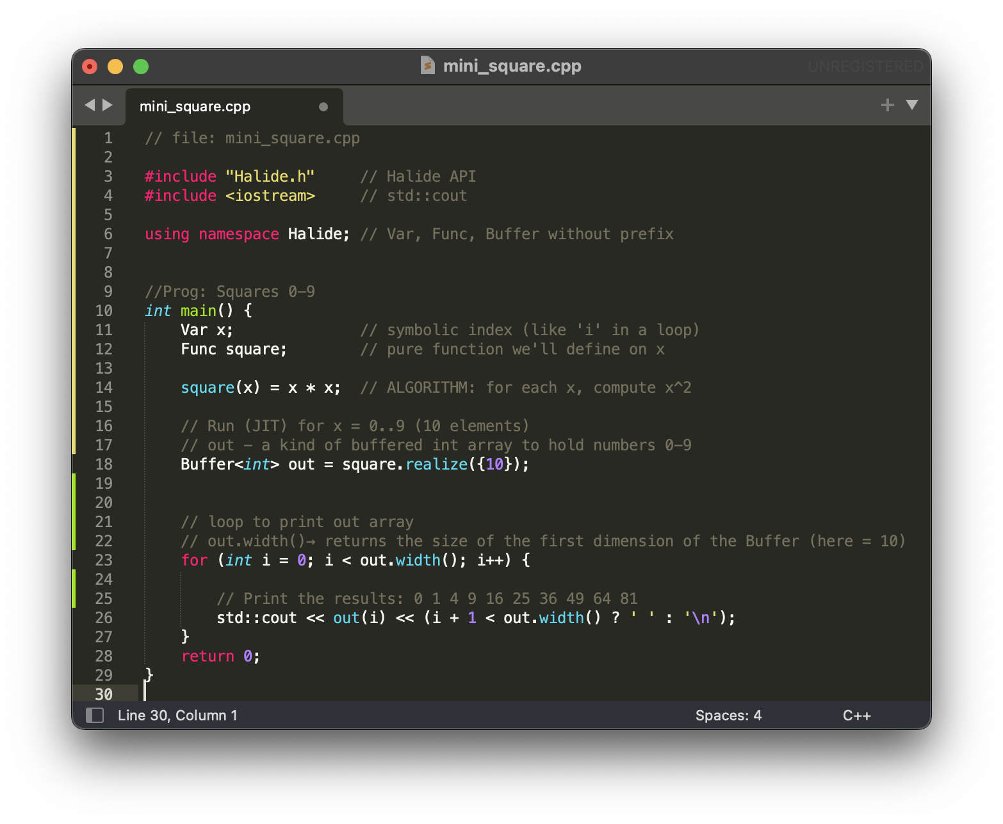
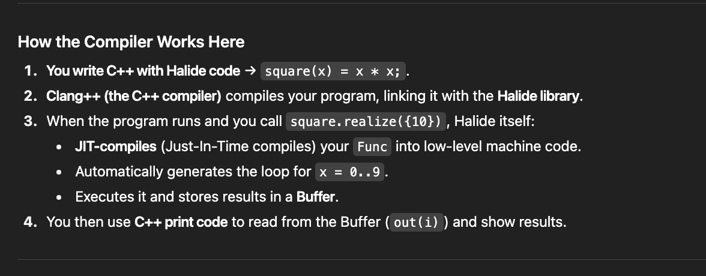
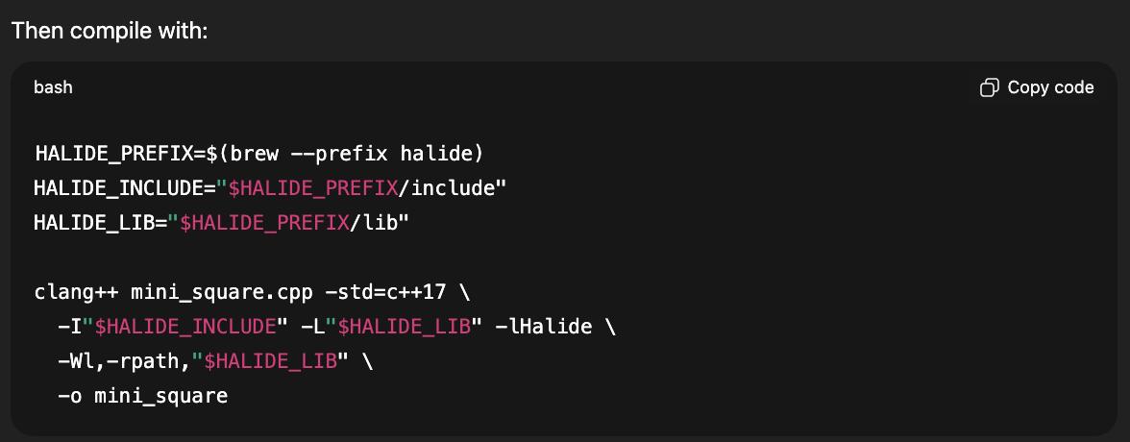
Implementation
Squares 0-9:
square.realize({10}):
square is the defined Halide Func (a pure formula).
.realize({10}) means: “evaluate this function over a domain of size 10.”
That is, compute values for x = 0, 1, 2, …, 9.
The result is returned as a Halide Buffer (a kind of array object).
out.width():
out is a Buffer (Halide’s array type).
“.width()” gives the size of the first dimension (the x-dimension).
In a 1-D example, .width() is just the length of the array.
In a 2-D buffer (like an image), .width() = number of columns, .height() = number of rows.
How the Compiler Works Here:
C++ with Halide code → square(x) = x * x;.
Clang++ (the C++ compiler) compiles your program, linking it with the Halide library.
When the program runs and you call square.realize({10}), Halide itself:
JIT-compiles (Just-In-Time compiles) your Func into low-level machine code.
-Automatically generates the loop for x = 0..9.
Executes it and stores results in a Buffer.
You then use C++ print code to read from the Buffer (out(i)) and show results.

Slide 8
Conclusion
Halide is a powerful tool for developing high-performance image and array processing pipelines
Its core principle of separating algorithm from schedule allows developers to write clean, productive code while still achieving optimal performance
While it has a learning curve and is not for general-purpose tasks, it is an invaluable tool for specialists in computational photography, computer vision, and machine learning.

